Slide 1
Principal Component Analysis of Molecular Fingerprints and Classification Approaches for Detecting Energetic Molecules
Team 5 LLNL Data Science Challenge
June 12, 2020
Fabian Santiago
Manuel Toro Garcia
Bharadwaj Satyanarayana
Lorenzo Scaturchio
Nathan Ross

Slide 2
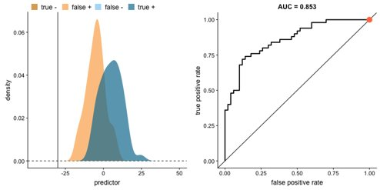
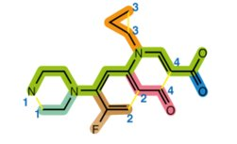
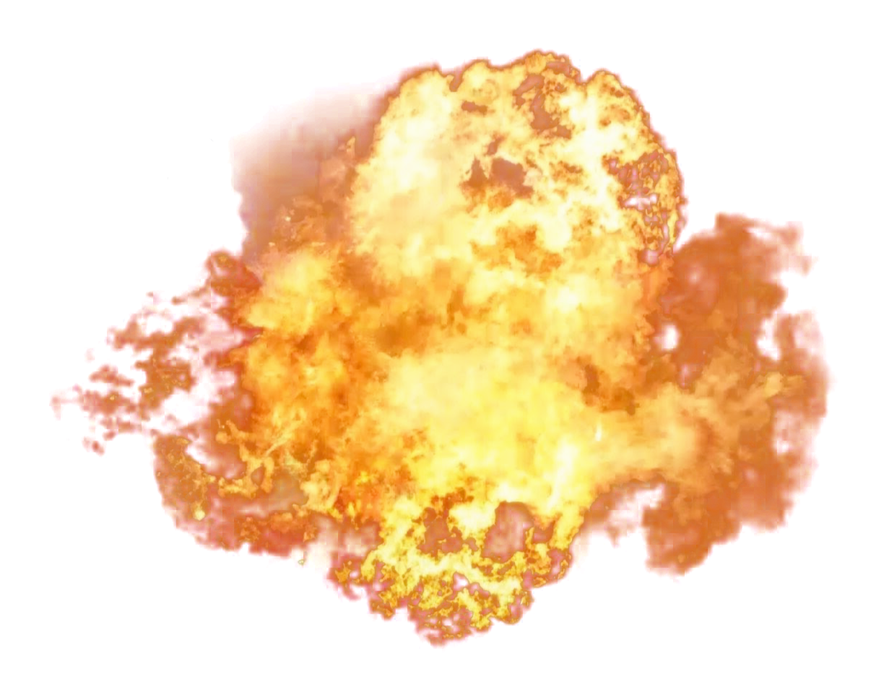
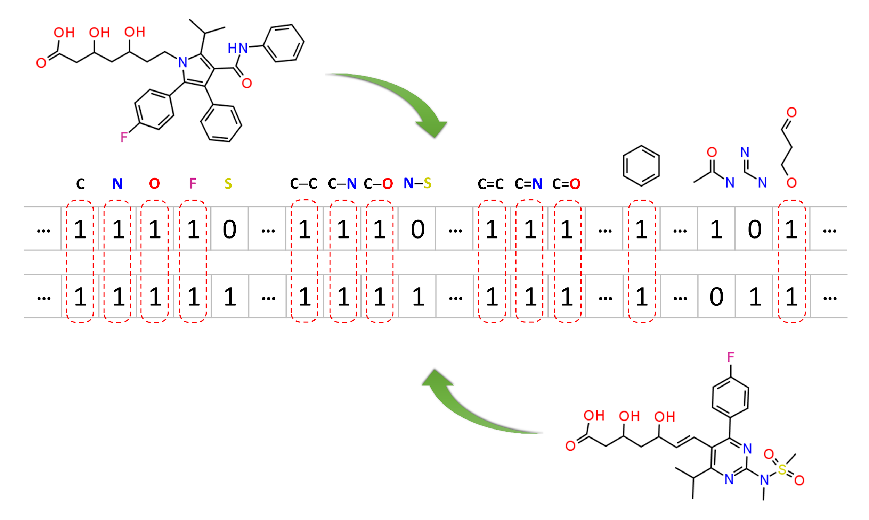
General Workflow Pipeline
Explosive or
Non-Explosive
Classification Method
Molecule
Questions​
What are the best predictive features?​
How do we assess the robustness of our classification method?​
How do we determine if our method is generalizable (work well on unseen data?)​
Molecular Features

Slide 3
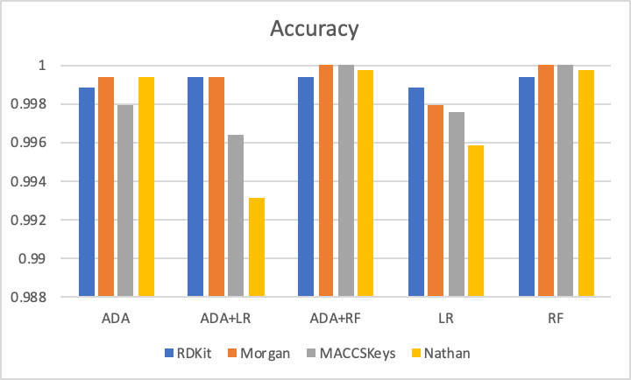
Cross-Validation
Notes:
Accuracy is not the best because of our imbalanced data set. An example will be that if 95 molecules are negative and only 5 are explosive, then the algorithm only has to classify everything as negative in order to get a 95% accuracy

Slide 4
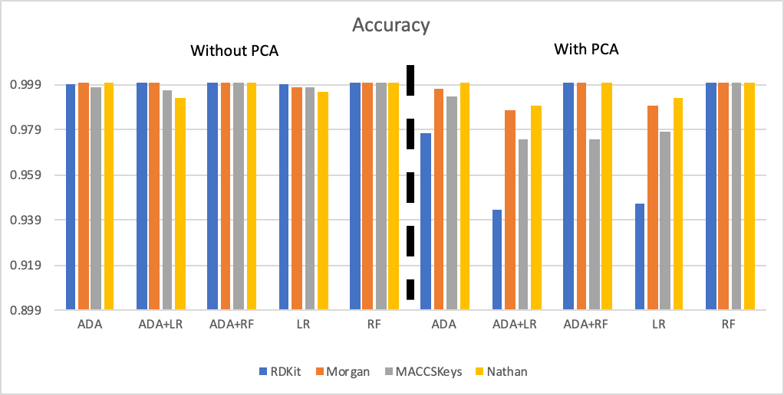
Cross-Validation
Notes:
Accuracy is not the best because of our imbalanced data set. An example will be that if 95 molecules are negative and only 5 are explosive, then the algorithm only has to classify everything as negative in order to get a 95% accuracy

Slide 5
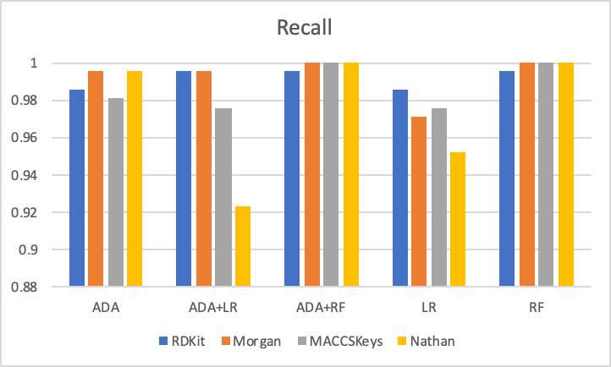
Cross-Validation
Notes:
recall is the number of correct results divided by the number of results that should have been returned.

Slide 6
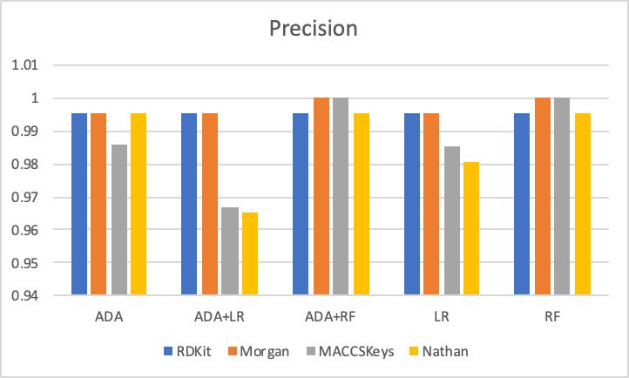
Cross-Validation
Notes:
precision is the number of correct results divided by the number of all returned results.

Slide 7
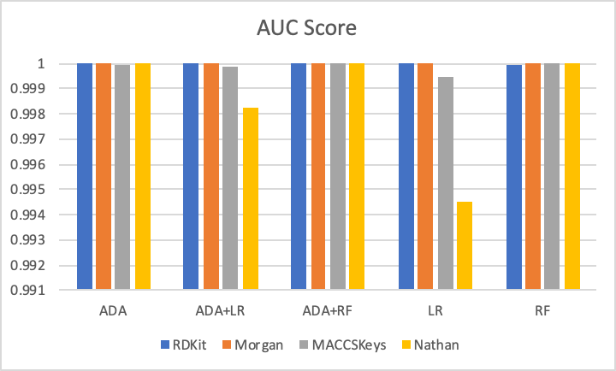
Cross-Validation

Slide 8
Summary of Results on Original Dataset
Molecular Fingerprints
Morgan Fingerprint
Recall
1.00
Precision
1.00
Machine Learning Methods
Random Forest
Precision
1.00
Recall
1.00

Slide 9
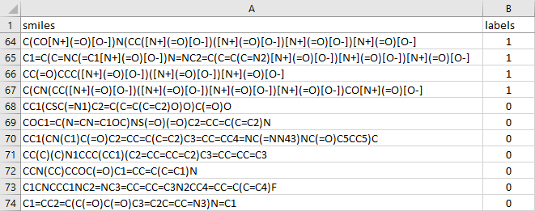
Model Results on Test Set
Testing Dataset Breakdown
Explosive molecules: 66
Non-explosive molecules: 982

Slide 10
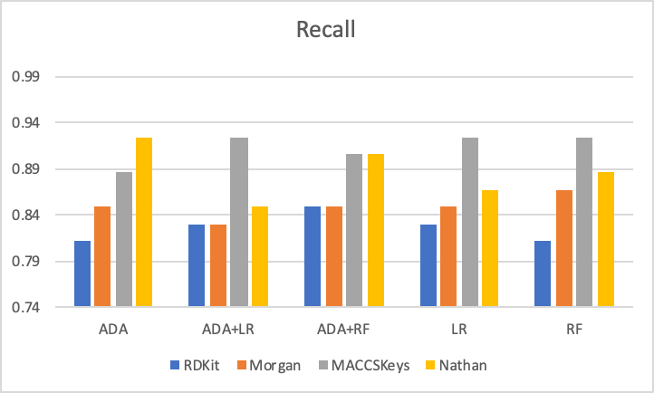
Test Set Results

Slide 11
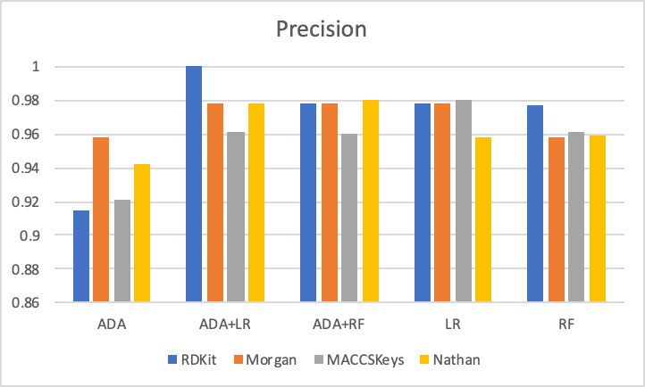
Test Set Results

Slide 12
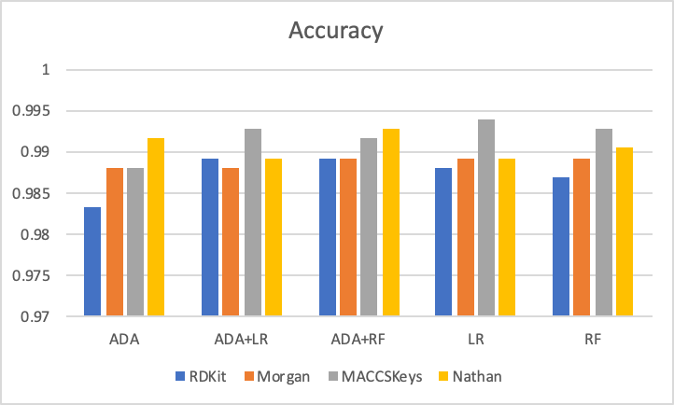
Testing Set Results

Slide 13
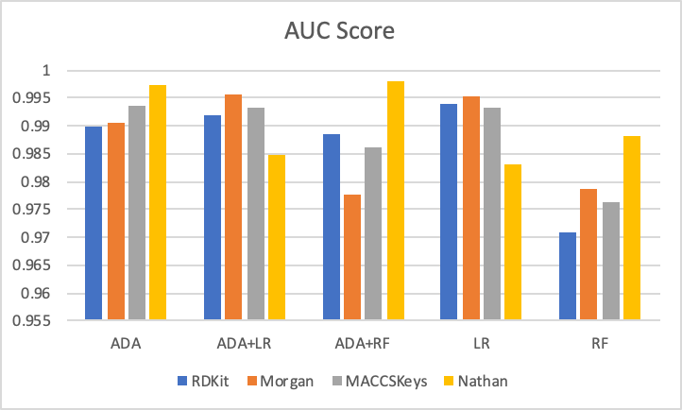
Testing Set Results

Slide 14
Recall Comparison
Training Set Data
Test Set Data
Row | RDKit | Morgan | MACCSKeys | Nathan
ADA | 0.986 | 0.995 | 0.981 | 0.995
ADA+LR | 0.995 | 0.995 | 0.976 | 0.923
ADA+RF | 0.995 | 1.000 | 1.000 | 1.000
LR | 0.986 | 0.971 | 0.976 | 0.952
RF | 0.995 | 1.000 | 1.000 | 1.000
Row | RDKit | Morgan | MACCSKeys | Nathan
ADA | 0.811 | 0.849 | 0.887 | 0.925
ADA+LR | 0.830 | 0.830 | 0.925 | 0.849
ADA+RF | 0.849 | 0.849 | 0.906 | 0.906
LR | 0.830 | 0.849 | 0.925 | 0.868
RF | 0.811 | 0.868 | 0.925 | 0.887

Slide 15
Precision Comparison
Training Set Data
Test Set Data
Row | RDKit | Morgan | MACCSKeys | Nathan
ADA | 0.995 | 0.995 | 0.986 | 0.995
ADA+LR | 0.995 | 0.995 | 0.967 | 0.965
ADA+RF | 0.995 | 1.000 | 1.000 | 0.995
LR | 0.995 | 0.995 | 0.986 | 0.980
RF | 0.995 | 1.000 | 1.000 | 0.995
Row | RDKit | Morgan | MACCSKeys | Nathan
ADA | 0.915 | 0.957 | 0.922 | 0.942
ADA+LR | 1.000 | 0.978 | 0.961 | 0.978
ADA+RF | 0.978 | 0.978 | 0.960 | 0.980
LR | 0.978 | 0.978 | 0.980 | 0.958
RF | 0.977 | 0.958 | 0.961 | 0.959

Slide 16
Accuracy Comparison
Training Set Data
Test Set Data
 | RDKit | Morgan | MACCSKeys | Nathan
ADA | 0.999 | 0.999 | 0.998 | 0.999
ADA+LR | 0.999 | 0.999 | 0.996 | 0.993
ADA+RF | 0.999 | 1.000 | 1.000 | 1.000
LR | 0.999 | 0.998 | 0.998 | 0.996
RF | 0.999 | 1.000 | 1.000 | 1.000
 | RDKit | Morgan | MACCSKeys | Nathan
ADA | 0.983 | 0.988 | 0.988 | 0.992
ADA+LR | 0.989 | 0.988 | 0.993 | 0.989
ADA+RF | 0.989 | 0.989 | 0.992 | 0.993
LR | 0.988 | 0.989 | 0.994 | 0.989
RF | 0.987 | 0.989 | 0.993 | 0.990

Slide 17
F1 Score Comparison
Training Set Data
Test Set Data
 | RDKit | Morgan | MACCSKeys | Nathan
ADA | 0.990 | 0.995 | 0.983 | 0.995
ADA+LR | 0.995 | 0.995 | 0.971 | 0.944
ADA+RF | 0.995 | 1.000 | 1.000 | 0.998
LR | 0.990 | 0.983 | 0.981 | 0.966
RF | 0.995 | 1.000 | 1.000 | 0.998
 | RDKit | Morgan | MACCSKeys | Nathan
ADA | 0.860 | 0.900 | 0.904 | 0.933
ADA+LR | 0.907 | 0.898 | 0.942 | 0.909
ADA+RF | 0.909 | 0.909 | 0.932 | 0.941
LR | 0.898 | 0.909 | 0.951 | 0.911
RF | 0.887 | 0.911 | 0.942 | 0.922

Slide 18
AUC Comparison
Training Set Data
Test Set Data
 | RDKit | Morgan | MACCSKeys | Nathan
ADA | 1.000 | 1.000 | 1.000 | 1.000
ADA+LR | 1.000 | 1.000 | 1.000 | 0.998
ADA+RF | 1.000 | 1.000 | 1.000 | 1.000
LR | 1.000 | 1.000 | 0.999 | 0.995
RF | 1.000 | 1.000 | 1.000 | 1.000
 | RDKit | Morgan | MACCSKeys | Nathan
ADA | 0.990 | 0.991 | 0.993 | 0.997
ADA+LR | 0.992 | 0.996 | 0.993 | 0.985
ADA+RF | 0.989 | 0.978 | 0.986 | 0.998
LR | 0.994 | 0.995 | 0.993 | 0.983
RF | 0.971 | 0.979 | 0.976 | 0.988

Slide 19
Summary of Results
Molecular Fingerprints
MACCS Key [Precision]
Precision
0.980
RDKit [Recall]
Recall
1.00
Machine Learning Methods
Logistic Regression [Precision/Recall]
Precision
1.00
Recall
0.922

Slide 20
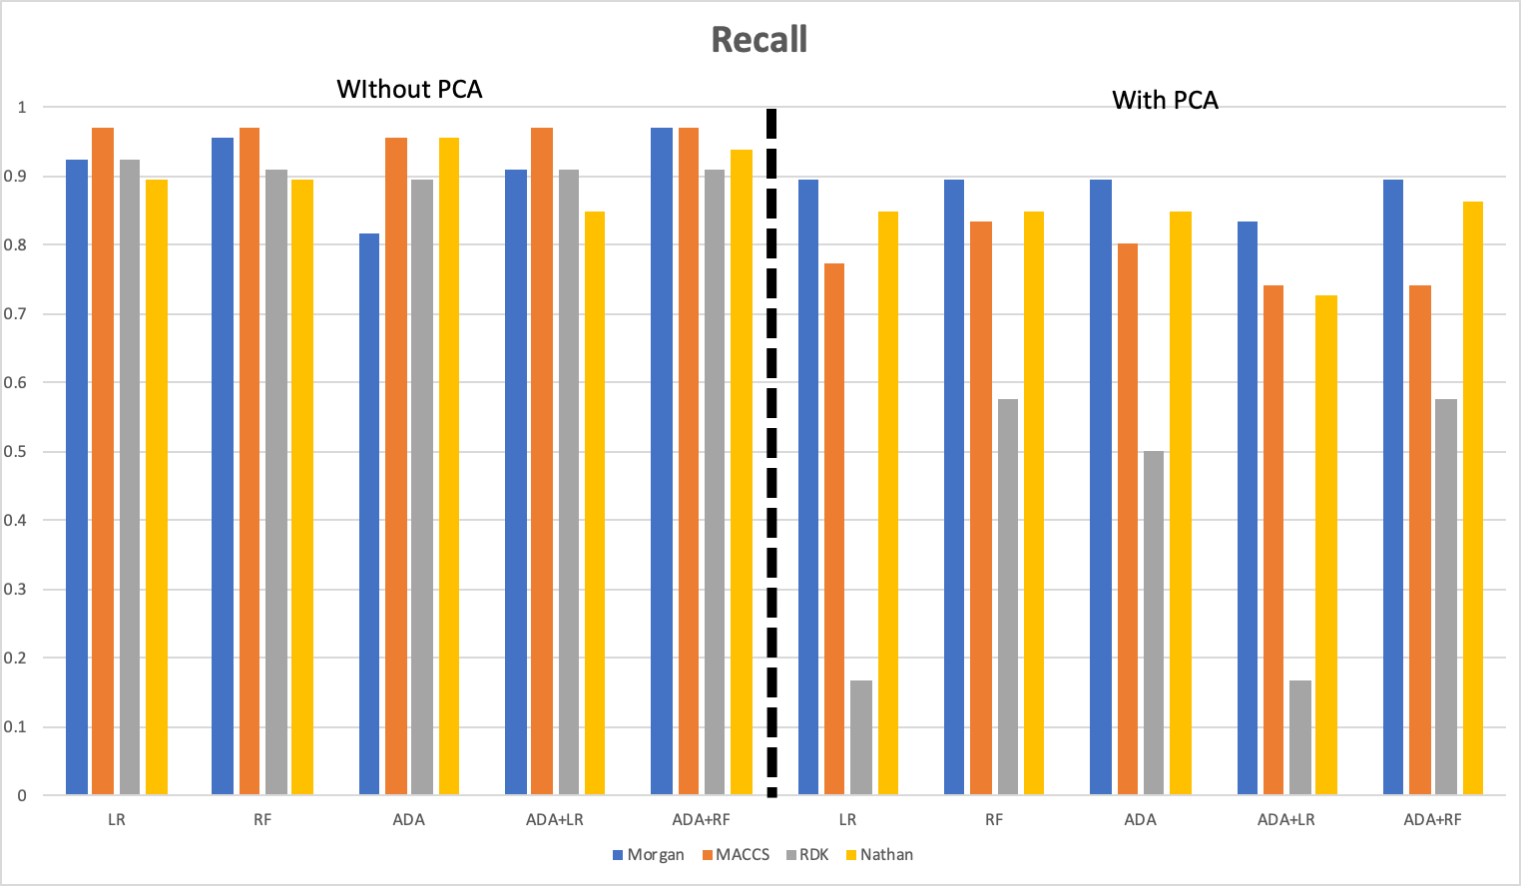
Final Test Results: Recall

Slide 21
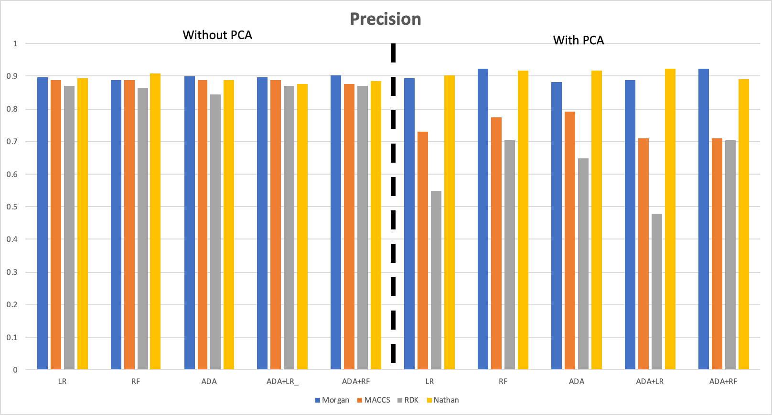
Final Test Results: Precision

Slide 22
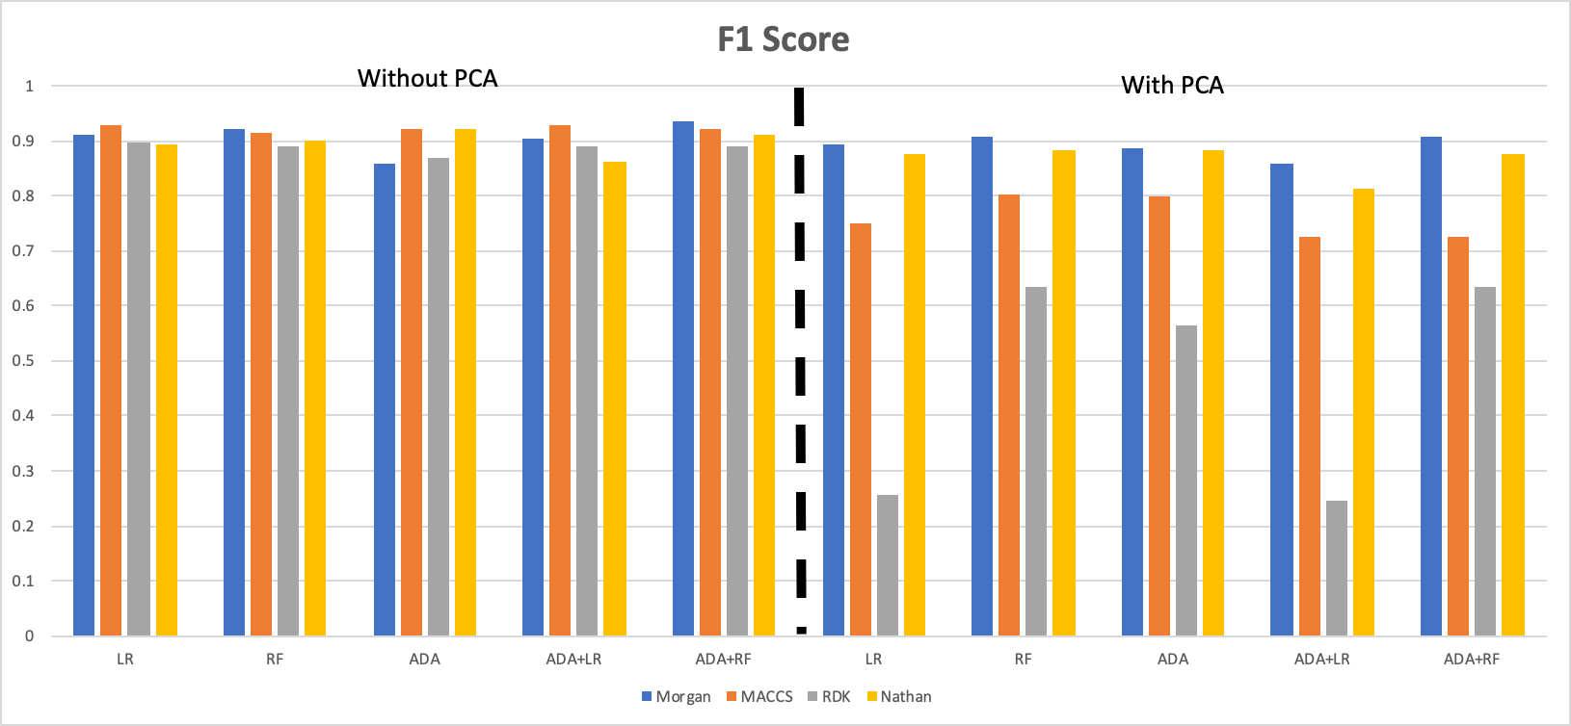
Final Test Results: F1_Score

Slide 23
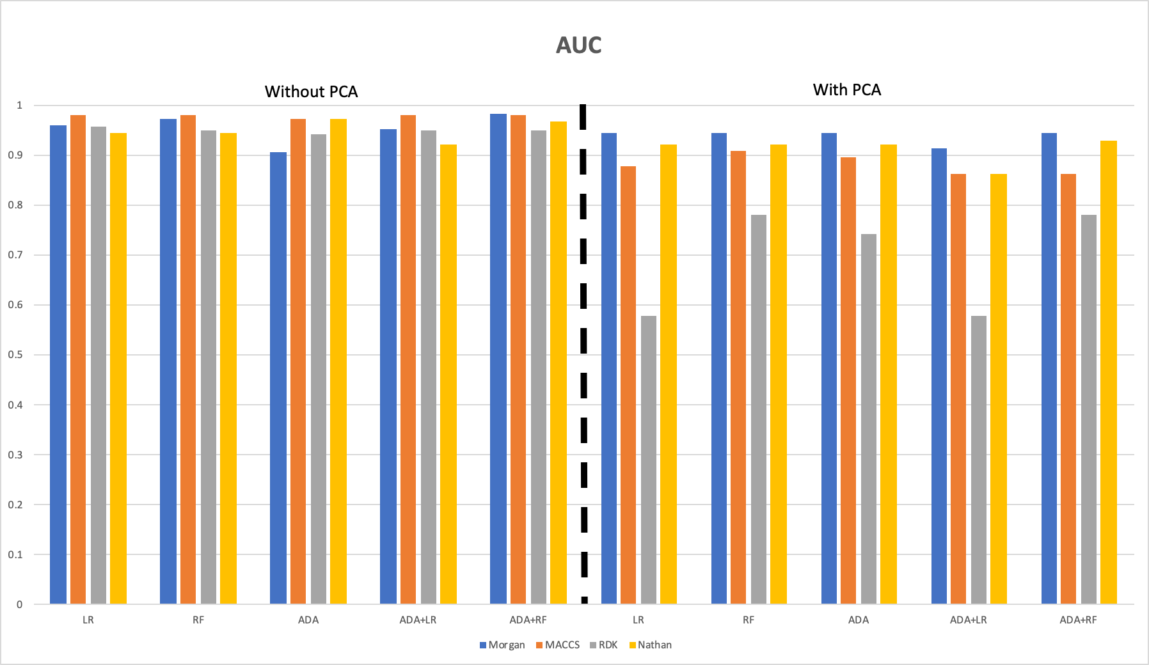
Final Test Results: AUC

Slide 24
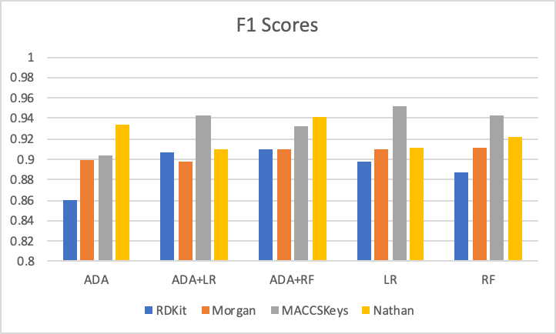
Testing Set Results

